Slide 1
Benchmarking Deep Learning Inference
Sharan Narang
June 28, 2017
Notes:
Deep learning works today for several different applications
“Does it work efficiently?” Or rather “Is deep learning fast?”
<number>

Slide 2

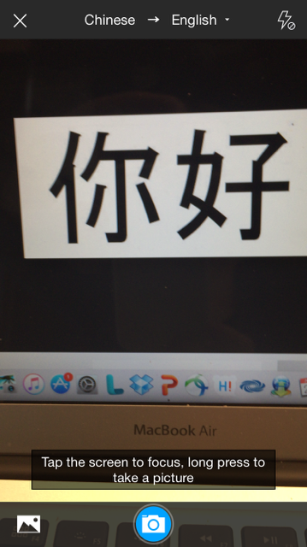


What can AI do for us?
Help us communicate with devices
Find what we are looking for
Help us communicate with each other
Drive us to work
Notes:
<number>

Slide 3
Scaling with Data
Notes:
<number>

Slide 4
How Large is our Data?
Notes:
<number>

Slide 5
Model Sizes
Notes:
<number>

Slide 6


Deep Learning Training
Large amount of data
Large and complex models

Slide 7



Training Many Large Models Quickly
We need to complete the cycle fast to explore many ideas.
Idea
Results
Code

Slide 8

Need for Speed
Notes:
<number>

Slide 9
DeepBench
First open source benchmarking tool to measure deep learning training performance
Notes:
<number>

Slide 10
What is DeepBench?
Benchmarking tool for neural network libraries and underlying hardware for training deep learning models
Includes a curated list of deep learning operations and workloads that are important and widely used in the industry

Slide 11
Training Operations
Matrix Multiply
Convolution
Recurrent
Communication cost

Slide 12
Where does DeepBench fit in?
Deep Learning Frameworks
E.g. PaddlePaddle, TensorFlow
Neural Network Libraries
E.g. cuDNN, MKL
DeepBench
Hardware
Notes:
<number>

Slide 13
Deep Learning Inference
Notes:
Define Inference
H/w is different from training and inference :- AWS v/s cluster,
I/O costs are different.
End goal is different compared to training (reduce time for training)
Inference involves latency and real time constraints
The model may need to be adapted before deployment.
<number>

Slide 14
Model Changes
Bidirectional Model
Forward Only Model
Outputs
Outputs
Inputs
Inputs
Time
Time

Slide 15
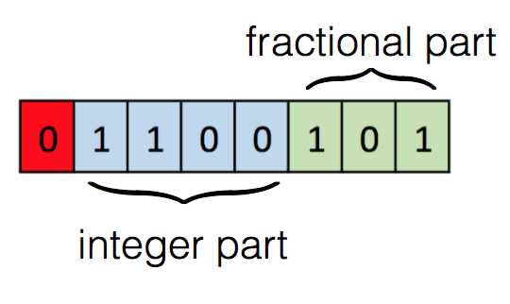
Precision
Training uses single precision 32 bit floating point numbers
FP32: 8 bits of exponent, 23 bits of mantissa
Fixed point presentation with 8 bits is sufficient for inference
Notes:
Centering and normalization?
<number>

Slide 16


Batch Size

Slide 17
Batch Dispatch for Efficiency
Time
Notes:
<number>

Slide 18
Sparse Neural Networks
Dense Neural Network
Sparse Neural Network
Notes:
<number>

Slide 19


Deployment Platform
Notes:
Image purchased
<number>

Slide 20
Inference workloads are
significantly different
from training
Notes:
Model changes, Low Precision, Batch Size, Sparsity
Can’t take training kernels and deploy them.
Need to focus on inference and pick the right kernels for it
<number>

Slide 21
DeepBench updates
Notes:
Built list of kernels to figure out the best processor based on application requirements
Guide hw vendors to develop better hardware for inference
<number>

Slide 22
Inference Operations
Matrix Multiply
Convolution Operations
Recurrent Operations
Sparse Operations – inference only kernel
Smaller Batch Size
Low Precision

Slide 23
Latency
Measuring latency of operations and kernels isn’t representative
Measuring latency involves benchmarking complete applications with deep learning frameworks
For server deployment, a user’s network bandwidth will have a significant impact on latency

Slide 24
Training updates to DeepBench
New Recurrent Layer - Gated Recurrent Unit (GRU)
Low Precision 16 bit training
New kernels from different models

Slide 25
DeepBench Inference Results
Notes:
<number>

Slide 26
Benchmarks – Matrix Multiply
Matrix Sizes | Server Deployment Time (milliseconds) | Device Deployment Time (milliseconds)
3072 x 1024, 1024 x 1 | 0.01 | 3.71
5124 x 2048, 2048 x 700 | 0.55 | 212.84
35 x 2048, 2048 x 700 | 0.07 | 1.94

Slide 27
Benchmarks - Convolutions
Input Size | Filter size | # of Filters | Server Deployment Time (milliseconds) | Device Deployment Time (milliseconds)
112 x 112 x 64 | 1 x 1 | 64 | 0.04 | 670
28 x 28 x 512 | 1 x 1 | 128 | 0.02 | 391
7 x 7 x 512 | 3 x 3 | 512 | 0.10 | 149

Slide 28
Benchmarks – Sparse Matrix Multiply
Matrix Sizes | Sparsity | Server Deployment Time (milliseconds) | Device Deployment Time (milliseconds)
7680 x 2560, 2560 x 1 | 0.95 | 0.03 | 1.01
7680 x 2560, 2560 x 1 | 0.9 | 0.07 | 2.10
10752 x 3584, 3584 x 1 | 0.95 | 0.06 | 1.99

Slide 29
How do I use it?
DeepBench blog post has more details:
https://svail.github.io/DeepBench-update/
Github repository has the kernels, results and software required for the benchmark:
https://github.com/baidu-research/DeepBench

Slide 30
Community Involvement
Deep learning researchers can provide new operations and workloads that are specific to their application
Software Developers working on neural network libraries or linear algebra libraries can contribute results for inference or training platforms
Hardware vendors and startups can contribute results for these benchmarks using their hardware and libraries

Slide 31


Sharan Narang sharan@baidu.com http://research.baidu.com
Silicon Valley AI Lab
Notes:
<number>

